Slide 1
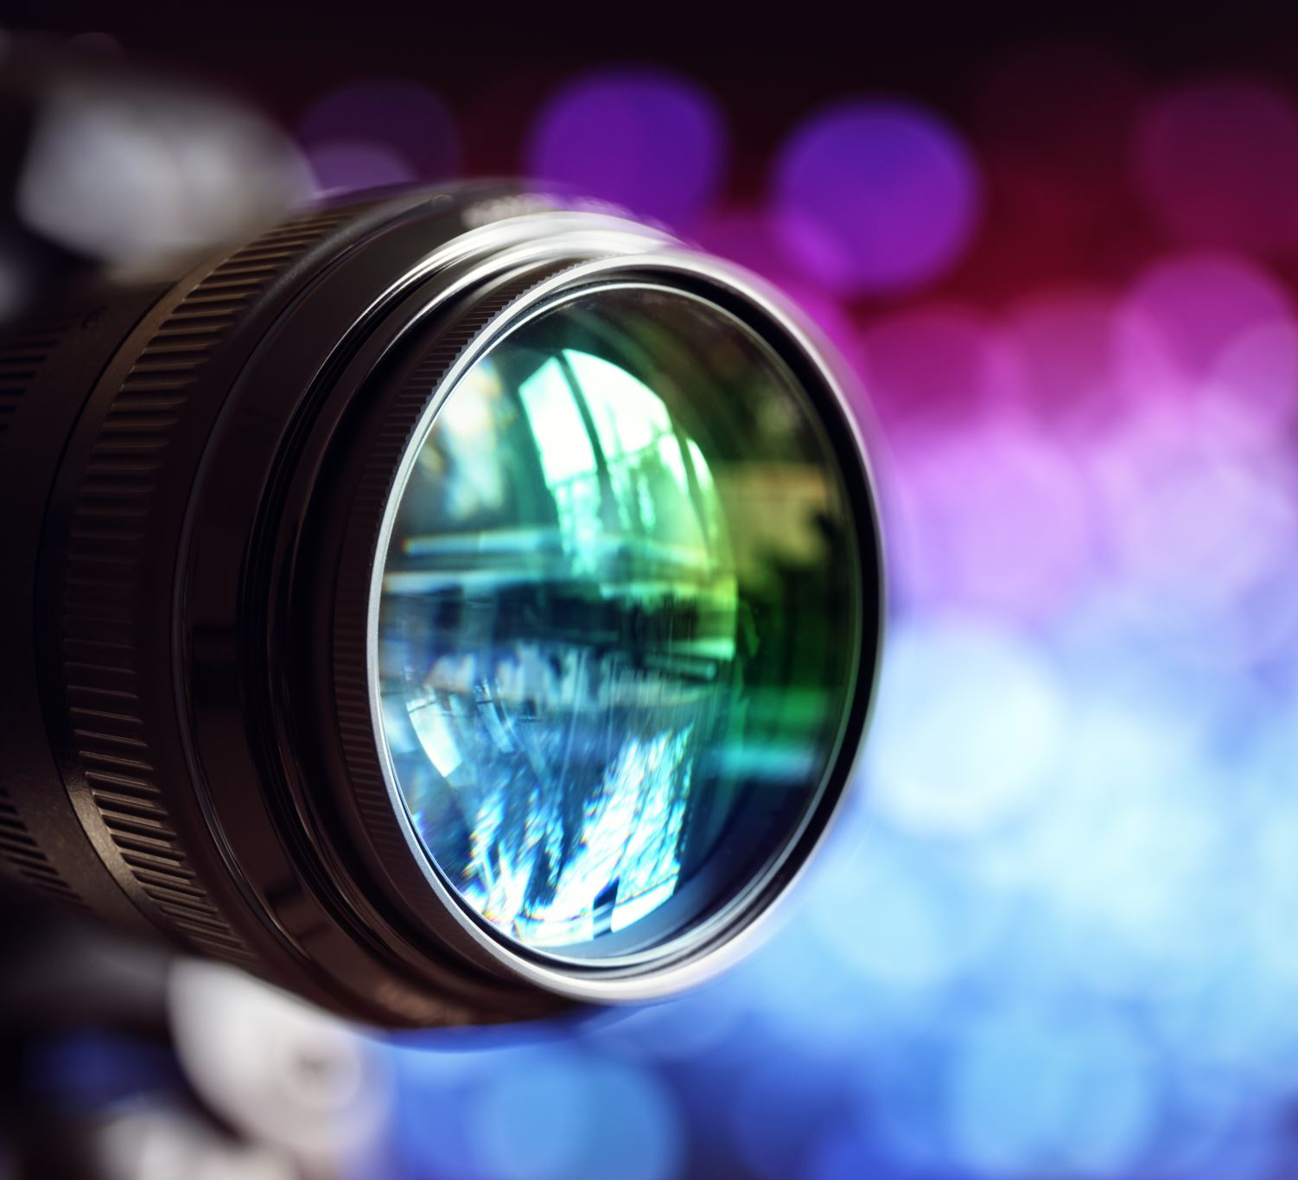
CREATING DYNAMIC CAMERAS WITH CINEMACHINE
VINCENT LANGEMEIJER, PEKKA KÄÄRIÄINEN, TIM DE KRUIJF, SAKU ERÄNIITTY, MATTIJN POSTHUMA

Slide 2
WHAT WILL WE COVER TODAY?
What is Cinemachine?
Different camera types of cinemachine
For each camera type:
A brief description
Exercises/Examples

Slide 3
AT THE END, YOU WILL HAVE LEARNED…
What cinemachine is
The different camera types cinemachine offers
How to set up each camera type
Some camera types in more detail

Slide 4
WHAT IS CINEMACHINE?
Procedural camera system
In-game cameras, cutscenes, cinematics, and much more…
Easy to use for designers

Slide 5
CINEMACHINE OFFERS THESE CAMERA TYPES
Virtual Camera
FreeLook Camera
Blend List Camera
State-Driven Camera
ClearShot Camera
Dolly Camera with Track
Dolly Track with Cart
Target Group Camera
Mixing Camera
2D Camera

Slide 6
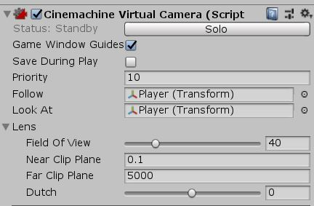
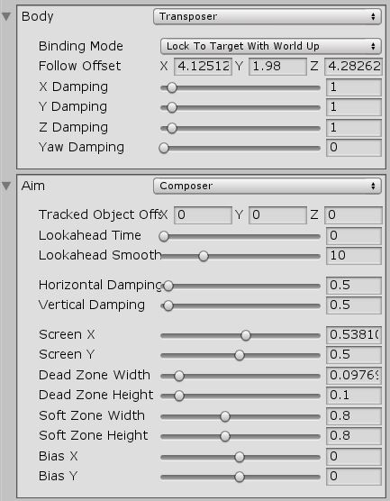
VIRTUAL CAMERA
The most important and basic type of virtual camera for 3D
Shows potential location for the main camera
Used by most other cinemachine cameras

Slide 7
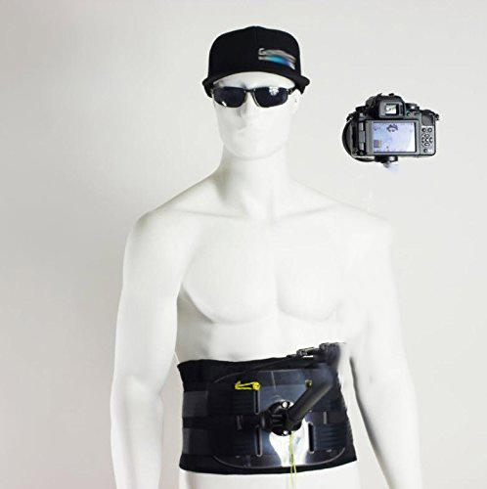
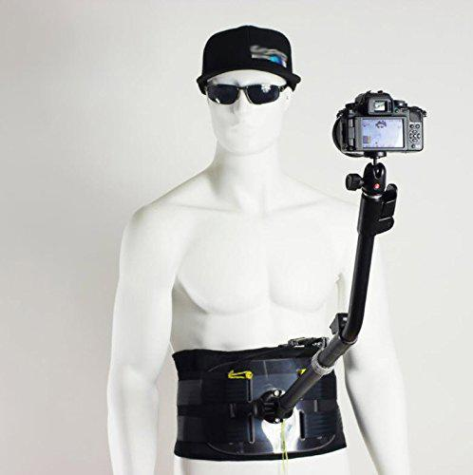
FREELOOK CAMERA
Ideal for third person camera
Automatically follows mouse movement
around the target

Slide 8
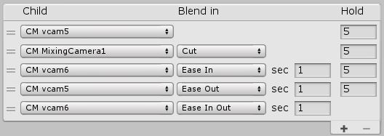
BLEND LIST CAMERA
Uses virtual cameras to create a list of shots
Timers define when to move from a camera to another
Great for introducing a level, for cut scenes or dialogs

Slide 9
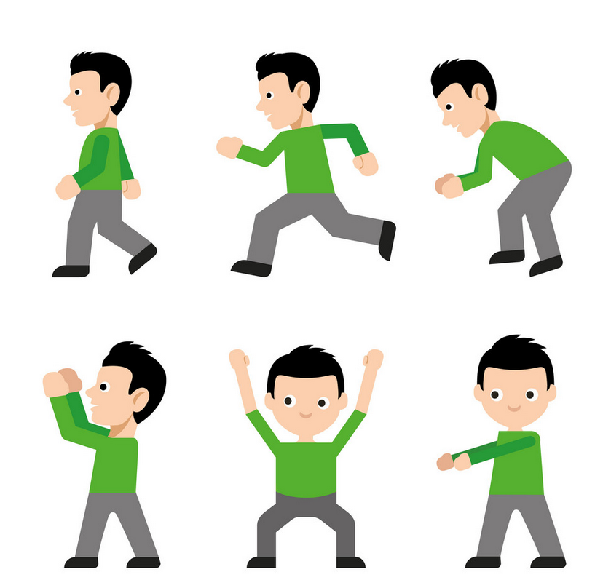
STATE DRIVEN CAMERA
Multiple child virtual cameras
Animation states
Different camera for each animation state

Slide 10
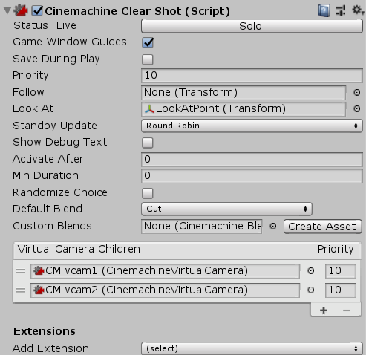
CLEARSHOT CAMERA
Uses virtual cameras and switches between them based on
collisions and/or distance
Looks at or follows a target

Slide 11
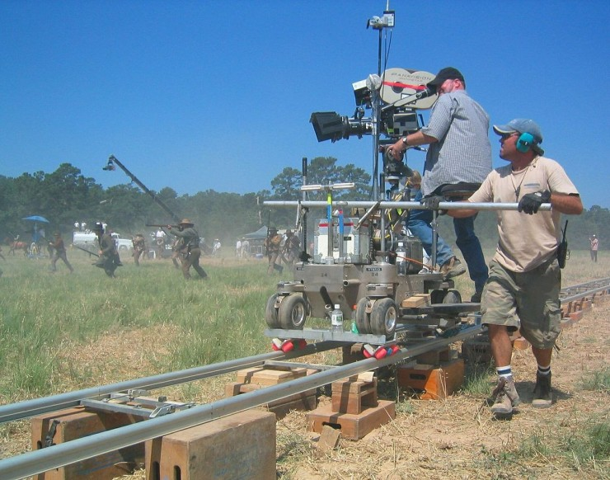
DOLLY CAMERA WITH TRACK
Move camera along track
Follow a target

Slide 12

TARGET GROUP CAMERA
Multiple objects
Single Look At target
Customizable center point or rotation

Slide 13

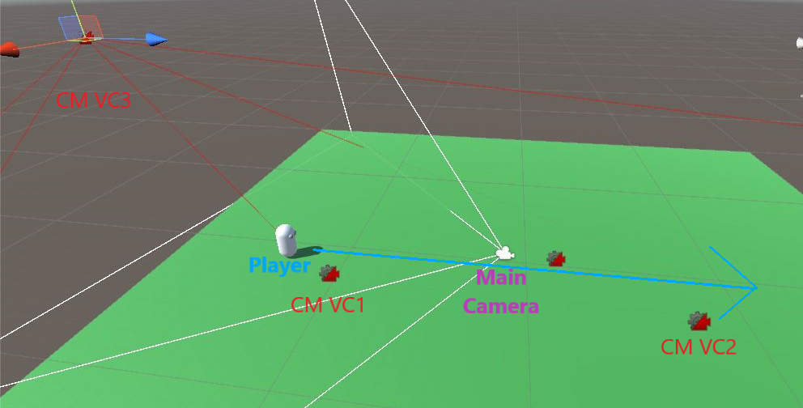
MIXING CAMERA
Uses up to eight virtual cameras
Picks the average location of the virtual cameras
Uses weights to prioritise one camera over another

Slide 14
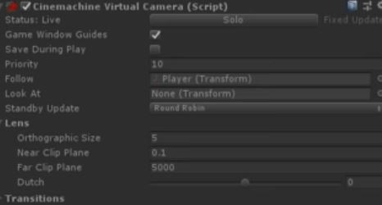
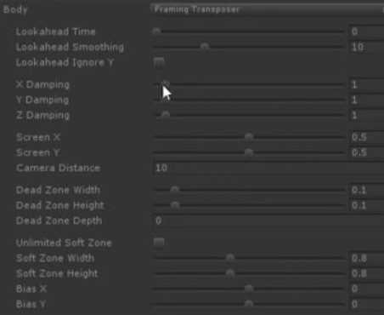
2D CAMERA
Very basic virtual camera for 2D games
Makes switching from camera to another much easier
Simply all you need for a following camera:

Slide 15
EXERCISES/EXAMPLES
Freelook
State Driven
Clear shot
Dolly & Track

